Slide 1
NIHARIKA SAI LALITHA PRESENTATION
Project Description
Approach
Tech-Stack Used
Insights
Result
Answers
Hiring Process Analytics

Slide 2
Approach
Taking the dataset into consideration and solving each query using steps of EDA
Tech-Stack Used
Used PPT for documenting, Google sheet and Excel for to perform the process of approach
Project Description
Insights
Gained knowledge on how to analyze each given problem and find relevant solutions to it using Excel graphs calculation, etc
Hiring process is the fundamental and the most important function of a company. Here, the MNCs get to know about the major underlying trends about the hiring process
Result
Learned the concepts of excel and steps of EDA .

Slide 3
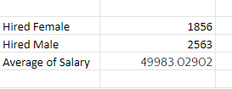
A. Hired Count
How many Males and Females are Hired?
Below is the formula I have used and got result , which shows in image(1).
Image(1)
B. Average Salary
What is the average salary offered in this company?
Above is the result I got after using the calculation shows in the image (right side).

Slide 4
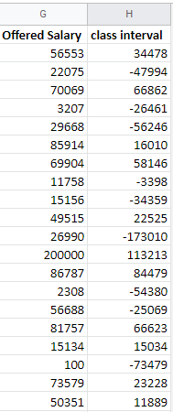
C.The class intervals for salary in the company
Product should meet a certain consumer demand, or it should be so compelling that consumers believe they need it. But they also must take into account supply costs.

Slide 5
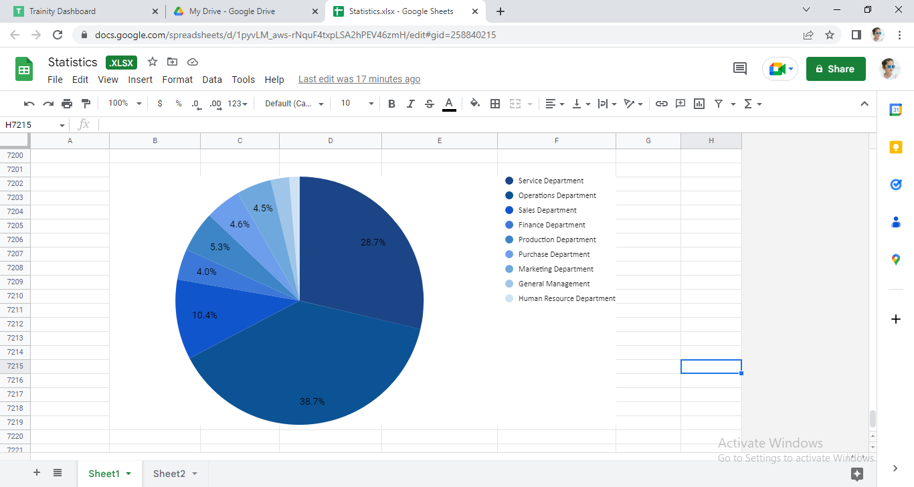
”
D : to show proportion of people working different department

Slide 6
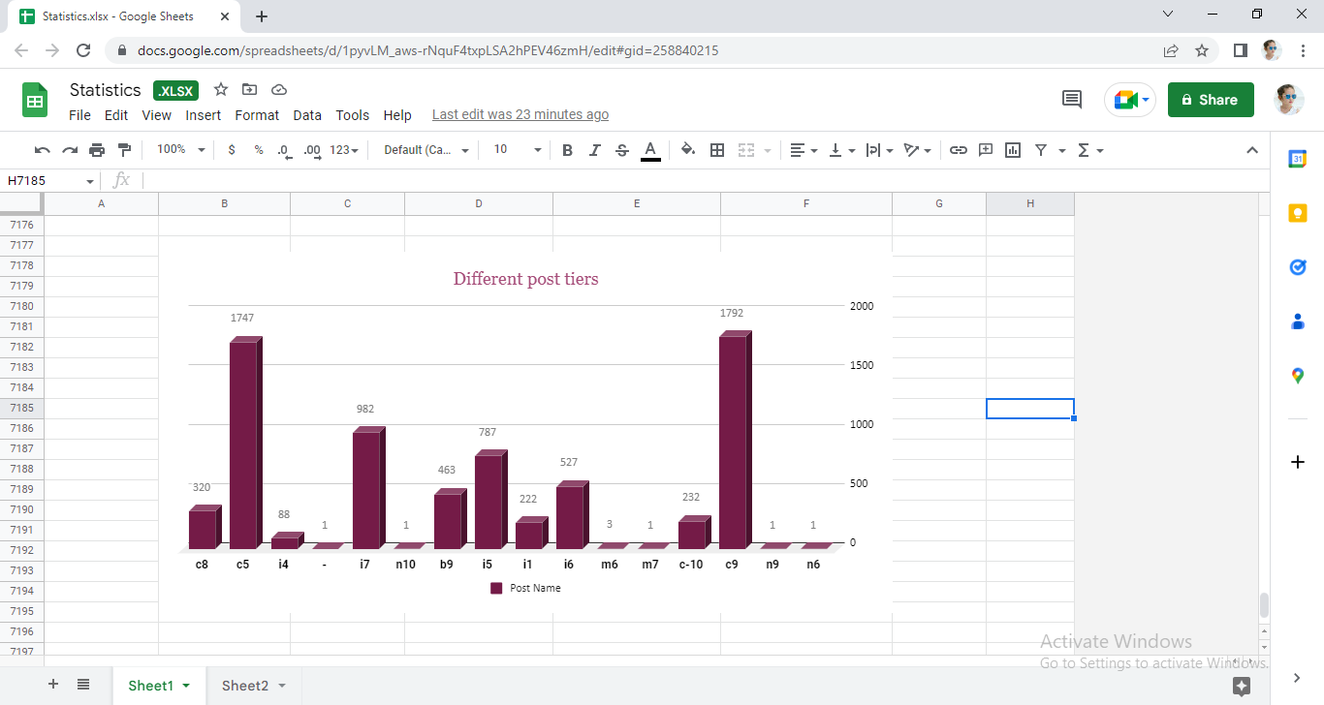
E : Represent different post tiers using chart/graph

Slide 7
REFERENCES
https://docs.google.com/spreadsheets/d/1pyvLM_aws-rNquF4txpLSA2hPEV46zmH/edit?usp=share_link&ouid=108829555020514927112&rtpof=true&sd=true
Refers to the excel : sharing the excel link to have a deep look into it

